Slide 1
Inferential Statistics Part (a)
LECTURE -04(a)
Course Instructor
Engr. Naina Said

Slide 2
What is Inferential Statistics?
CSE-422: Data Analytics
Inferential Statistics is used to draw inferences beyond the immediate data
available.
If we were to find the number of times per week the teens in Pakistan eat junk,
we have two option.
Meet every teen in the country and survey them. (not impossible but
requires enormous resources)
Hand pick some teens, survey them and then make inference about the
entire teen population.
Inferential statistics helps us in making inferences about the population from the sample.

Slide 3
Probability Density Curves/Distribution
CSE-422: Data Analytics

Slide 4


Slide 5
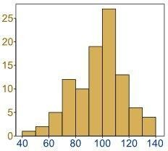
Histogram Recap
CSE-422: Data Analytics
A histogram is an approximate representation of the “distribution” of numerical data.

Slide 6
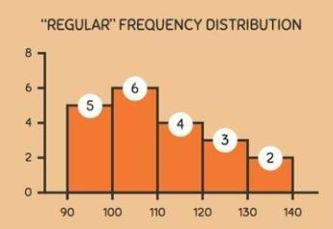
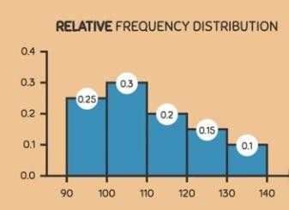
Histogram Recap
CSE-422: Data Analytics
Histograms can either give us the regular frequency distribution of a variable or relative frequency distribution of a variable.

Slide 7
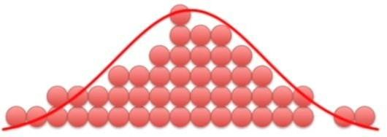
Approximating the Histogram with a Curve
CSE-422: Data Analytics
But why??

Slide 8
Statistical Distribution
CSE-422: Data Analytics
Distribution gives us the probabilities of occurrence of different possible outcomes for an experiment.
We can use a curve to approximate the histogram and that will give us the
probabilities of occurrence of a particular event.
The curve gives us the same information as the histogram.
But then, why do we even need it?
Because
Relative frequency histogram can be used for discrete variables.
For continuous variables, we would need a curve for approximation.

Slide 9
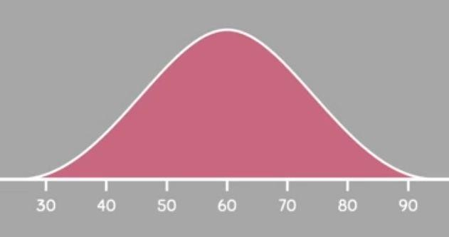
Approximations Using the Curves
CSE-422: Data Analytics
We can use a curve/distribution to make approximations.
Total area under the curve = 1.
Consider the following test scores.
What can you say about these scores?

Slide 10
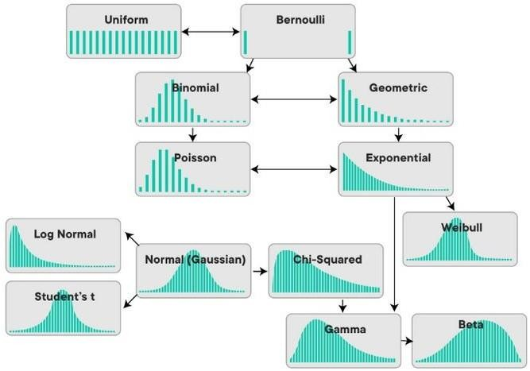
Different Types of Statistical Distribution
CSE-422: Data Analytics

Slide 11
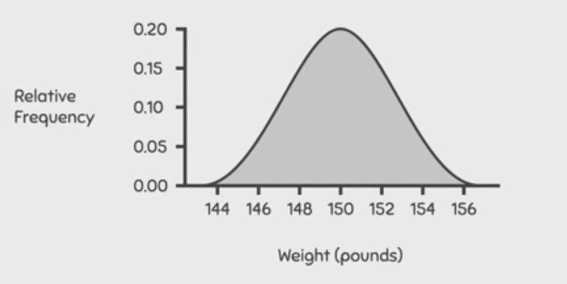
Example 1
CSE-422: Data Analytics
The probability density curve below shows the weights of people measured in pounds. What percentage of people weigh between 150 and 152 pounds?

Slide 12
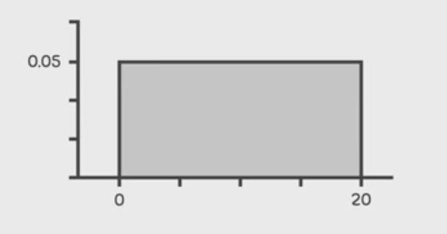
Example 2
CSE-422: Data Analytics
For the uniform density curve shown below, what percentage of values are between 12.3 and 18.6?

Slide 13
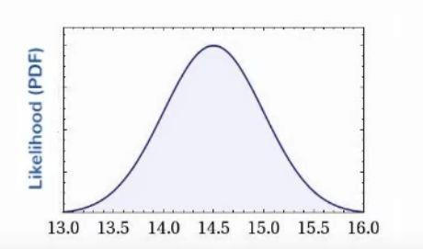
The Normal Distribution
CSE-422: Data Analytics
Also called a bell curve because it looks like a bell!
Is always centered at the mean of the data.
The width of the curve is defined by the standard deviation.
Example : Flight time for LA to Sydney.
Hours

Slide 14
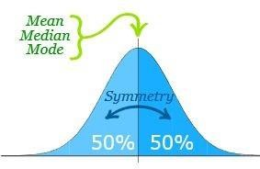

The Normal Distribution Continued..
CSE-422: Data Analytics
To draw a normal distribution, we need
The average value of the measurement. This tells us where the center of the
distribution should be.
The standard deviation. This tells how wide the curve should be.
For normal distributions, mean=median=mode.
Symmetry about the center.
50% of values less than the mean and 50% greater than the mean
A variable X which follows a normal distribution is
represented as

Slide 15
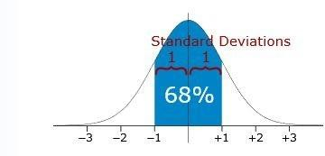
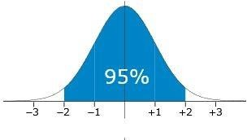
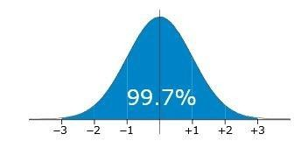
68-95-99.7 Rule for Normal Distribution
CSE-422: Data Analytics
68% of values are within 1
standard deviation of the mean
95% of values are within
2 standard deviations of the mean
99.7% of values are within
3 standard deviations of the mean

Slide 16
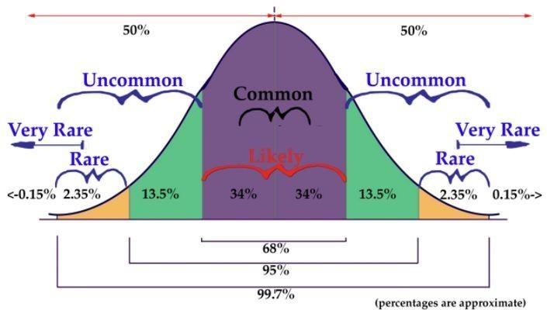
68-95-99.7 Rule for Normal Distribution
CSE-422: Data Analytics

Slide 17
Example 1
CSE-422: Data Analytics
Suppose the pulse rates of 200 college men are bell-shaped with a mean of 72 and standard deviation of 6.
According to the empirical rule of normal distribution
About 68% of the men have pulse rates in the interval 72+1(6)=[66,78]
About 95% of the men have pulse rates in the interval 72+2(6)= [60,84]
About 99.7% of the men have pulse rates in the interval 72+3(6) =[54,90]

Slide 18
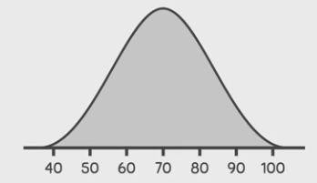
Example 2
CSE-422: Data Analytics
The normal distribution shown below has a standard deviation of 10.Approximately what area is contained between 70 and 90? OR what is the probability that someone will get a score between 70 and 90?

Slide 19
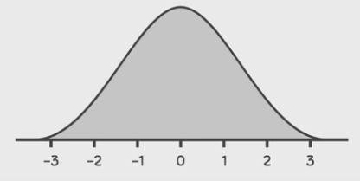
Example 3
CSE-422: Data Analytics
The normal distribution shown below has a standard deviation of 1.Approximately what area is contained between -2 and 1 ?

